Slide 1
DSAP Diné School
Department of Diné Education
Assistant Superintendent
Timothy Benally
timbenally@nndode.org

Slide 2
Diné School Accountability Plan (DSAP)
All Bureau-funded schools
Common Core State Standards (CCSS) for English Language Arts/Literacy and Mathematics (higher standards)
Partnership for Assessment of Readiness for College and Careers (PARCC) assessments (rigorous measure)
PARCC is aligned to CCSS
Reaches across three states

Slide 3
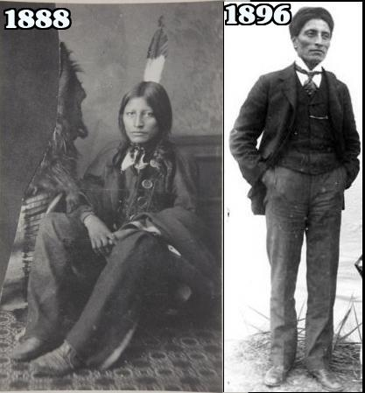
Then and now
Traditional Bureau of Indian
Indigenous Education Affair >> BIE

Slide 4
Rock Point Community School
From a domain to a familiar language base school.
Full immersion
All content
Introduction to the English Language
Produced successful students

Slide 5
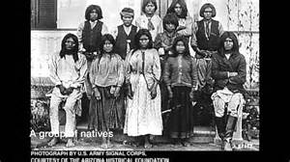
Reverse back to?
…incorporate those elements that are unique and are essential to sustaining Diné people and our culture.

Slide 6
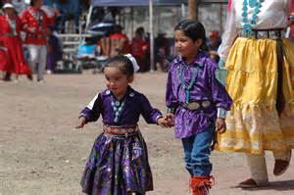
DSAP School
From a domain to an unfamiliar language based school.
Today most of our children are monolingual
At Kindergarten we will introduce the Navajo language
Third grade will be full immersion
Navajo language will decrease after third grade
50-50 up to 12th grade

Slide 7
Not a quick fix!
Cooperation between states and school systems
World class school system
A holistic approach to solving and improving Indian Education achievement proficiency
Home environment is helpful and sometime it’s a challenge
If we concentrate on the children we will succeed. But if we talk who will control, it will not help our children.
The state of Indian Education across the COUNTRY

Slide 8
What is the “Big” goal of DSAP?
Close the achievement gap
Strengthen the identity of Navajo youth
Preserve the Navajo Language and Culture
Turn around the percentage of language lost
Success in life
Social ills are minimized
Self sustaining
Students succeed!

Slide 9
Our Elders say….
Díí bee ‘ąąnídítíhí nahalin
T’áásh hool’áágóó náhinishnáa dooleeł
Saad t’ááła’í silįįji’ éí aaji’ ts’ííd nahonít’i’
T’ááhó ‘ájít’éego t’éiyá ts’ííd hodeezt’i’

